Slide 1
Harmony Search Algorithm and Firefly Algorithm
Dr. Manjubala Bisi
Assistant professor
Department of CSE
NIT Warangal

Slide 2
Outline
Introduction Harmony Search Algorithm (HSA)
Initialization of harmony memory
Improvisation of new harmony vector
Harmony memory updating
Introduction Firefly Algorithm
Applications

Slide 3
Introduction HSA
Essential relationship between music and mathematics.
Harmony refers to sound request caused from two or more instruments play at the same time.
Harmony evaluates relationship between two or more sound waves.
Music inspired harmony based optimization algorithm.
HSA based on improvisation process of a skilled musician.
Music band improves rehearsal after rehearsal, HSA improves iteration after iteration.

Slide 4
Analogy between Music and Optimization
In HSA, each musician (Decision variables) plays (generates) a note (value) for finding a best harmony (global optimum) all together.
Comparison factor | Harmony improvisation | Optimization process
Targets | Aesthetic standard | Objective function
Best states | Fantastic harmony | Global optimum
Components | Pitches of instruments | Values of variables
Process unit | Each procedure | Each iteration

Slide 5
Analogy between Music and Optimization
Musical Improvisation | Optimization
Playing a note from the harmony to harmony | New variables values are selected from the harmony memory
Playing a note which is close to another one stored in memory | Replaced new values with other values close to current values
Playing a random note from the possible range | New variable values are randomly selected from the possible range

Slide 6
HSA
It is a population based metaheuristic algorithm inspired from the musical process of selecting for a perfect state of harmony.
It has been proposed by Geem et al. in 2001.
The pitch of each musical instrument determines the aesthetic quality , just as the fitness function value determines the quality of the decision variable.
In the music improvisation process, all players sound pitches within possible range together to make a good harmony.
If all pitches make a good harmony, each player stores in its memory, that experience and the possibility of making a good harmony is increased next time.
In optimization, the initial solution is generated randomly from decision variables within possible range.
If the objective function values of these decision variables is good to make a promising solution, then the possibility to make a good solution is increased next time.

Slide 7
Initialization of Harmony Memory
The initial population HM contains HMS vectors is generated randomly,
Where, X_{i} = X_{ij}, i = 1,2,….., HMS
and j=1,2,……,n
The HM matrix is fitted with HMS vectors as follow:
X11 | X12 | . | . | . | X1n
X21 | X22 | . | . | . | X2n
. | . | . | . | . | .
. | . | . | . | . | .
XHMS1 | XHMS2 | . | . | . | XHMSn

Slide 8
Improvisation of new harmony vectors
Harmony memory considering rule (HMCR)
Choosing a value from HM
HMCR is the probability of choosing value from historical values stored in HM
HMCR ( 70% to 95%)
A new random number r1 is generated within the range [0, 1]
If r1 < HMCR, then the first decision variable in the new vector X_{ij}^{new} is chosen randomly from the values in the current HM as:
X_{ij}^{new} = X_{ij}, X_{ij} € {X_{1j}, X_{2j}, ……..X_{HMSj}}

Slide 9
Pitch adjusting rate (PAR)
The obtained decision variable from the HMCR is further examined to understand if it needs to pitch adjustment or not.
Generate a new random number r2 within the range [0,1]
If r2 < PAR, then the pitch adjustment decision variable is calculated as follows:
X_{ij}^{new} = X_{ij} +- rand(0,1) .BW
Where BW is the bandwidth factor which is used to control the local search around the selected variable in the new vector.

Slide 10
Random Initialization rate
If the condition r1 < HMCR fails, the new 1st decision variable in the new vector X_{ij}^{new} is generated randomly as
X_{ij}^{new} = l_{ij} + (u_{ij} – l_{ij}) . Rand(0,1)
Where, l is the lower and u is the upper bound for the given problem.

Slide 11
Harmony memory updating
After the harmony vector (X_{new}) is generated, it will replace the worst harmony vector (X_{worst}) in the harmony memory if its objective function value is better than the objective function value of the worst harmony vector.
If (X_{new} < X_{worst}) (for minimization problem)
Then update HSA as X_{worst} = X_{new}

Slide 12
Algorithm
Initialize parameters (set as HCMR, PAR, BW, HMS, MAXT and Dim)
Construct initial harmony memory randomly
Evaluate harmony performance using fitness function
Find out and store best / worst solution
while (current iteration <= Max-iteration)
_{if (rand < HMCR)}
Choose existing harmony redundancy
_{if (rand < PAR)}
_{Adjust Pitch randomly}
_{endif}
_{else}
_{Generate random harmony}
Compare New harmony with worst harmony
_{endif}
_{endwhile}
Return Best harmony as the optimal solution

Slide 13
Procedure (HSA)
Set the parameters HMS, HMCR, PAR, BW and NT
Set t = 0
for (i=1; i< HMS do)
Generate an initial population (HM) HMS (HMS is the harmony size / population size)
Evaluate the fitness function of each harmony vector (Xi)
end for

Slide 14
Procedure (HSA)
Repeat
Generate a new solution (harmony) Xi as follows:
for (i=1; i<= HMS do) (Number of harmony)
for (j=1; j<=n do ) (Number of decision variables)
if (r1 < HMCR)
X_{ij}^{new} = X_{ij}
If (r2 <PAR)
X_{ij}^{new} = X_{ij} +- r3. BW, where r1, r2, r3 € (0,1)
End if

Slide 15
Procedure (HSA)
If X_{ij}^{new} < l then
X_{ij}^{new} = l
End if
If X_{ij}^{new} > u then
X_{ij}^{new} = u
End if
else

Slide 16
Procedure (HSA)
X_{ij}^{new} = l_{ij} + r4 (u_{ij} – l_{ij}), where r4 € (0,1)
End if
End if
End for
if (X_{ij}^{new} < X_{worst} ) then
Update the HM as X_{worst} = X_{ij}^{new} End if
Set t = t+1
Until (t < Nt)
Produce the best solution (harmony vector ) X as the optimal solution

Slide 17
Steps of HSA
Initialization of Optimization Problem and Control Parameters
Initialization of Harmony Memory
Creating a New Harmony Vector
Revising Harmony Memory
Evaluating Termination Condition

Slide 19
Control Parameters of HSA

Slide 20
Control Parameters of HSA
Pitch adjustment rate (PAR)
Harmony memory consideration rate (HMCR)
Distance bandwidth (BW)
Harmony memory (HM)
Termination criteria
Many researchers modified the structure of original HAS by changing PAR, HMCR, and BW.

Slide 21
Improved HSA (IHSA)
The values of PAR and BW were dynamically updated according to the generation.
PAR(gn)denotes the pitch adjustment rate in generation gn
PAR_{min} and PAR_{max} are the minimum and maximum adjustment rates.

Slide 22
Improved HSA (IHSA)
BW(gn)represents the distance bandwidth in generation gn
BW_{min} and BW_{max} are the minimum and maximum bandwidths
Challenging task of Improved HSA is to determine the appropriate values of lower and upper limits of BW.

Slide 23
Self-adaptive HSA (SHSA)
To capture the best solution for generating new harmonies.
The distance bandwidth is dynamically decreased with increase in number of generation.

Slide 24
Explorative HSA (EHSA)
Used the population variance for modification.
The distance bandwidth was dynamically changed to proportional to standard deviation of the current population.
Where σ(zi)represents the standard deviation of the current population, zi.

Slide 25
Variants of HSA
Improved HSA
Chaotic HSA
Binary HSA
Multi-objective HSA
Hybrid HSA

Slide 26
Applications of HSA
Scheduling problems
Train neural network
Engineering optimization problems
NP hard combinational optimization problem
Data fusion in Wireless Sensor Network

Slide 29
Example

Slide 30
Firefly Algorithm
Firefly algorithm is a bio-inspired metaheuristic algorithm for optimization problems. It was introduced in 2009 at Cambridge University by Yang et al.
The algorithm is inspired by the flashing behavior of fireflies at night.
Any firefly can be attracted to any other brighter one.
The brightness of a firefly is determined from the encoded objective function.
The attractiveness is directly proportional to brightness but decreases with distance, and a firefly will move towards the brighter one, and if there is no brighter one, it will move randomly.

Slide 31
Characteristics of Fireflies
Fireflies has a flash light as a major characteristic. It can be used to attract possible mates and to warn from potential threats or enemies
This working of flash light follow the physics' rule:
With increase in distance, flash light intensity decrease according to law of physics,
where r is distance and I is intensity of light.
The firefly blink their flash light at regular time instances
Whenever a firefly comes in neighborhood, they come together and form a couple

Slide 32
Flowchart

Slide 34
Firefly Algorithm
Generate a random solution set {x1,x2,……,xn}
Compute intensity for each solution member {f1,f2,……,fn}
Move each firefly towards other brighter fireflies, and if there is no other brighter firefly, move it randomly
Update the solution set.
Terminate if a termination criterion is fulfilled otherwise go back to step 2.

Slide 35
Position update of the firefly
If a firefly located at X_{j} is more attractive (brighter) than another firefly located at X_{i}, the firefly located at X_{i} will move towards X_{j}.
X_{i} ^{t+1} = X_{i}^{t} + ᵝ e (-ᵞ r²_{ij} (X_{j}^{t} – X_{i}^{t})) + α_{t} Є_{i}^{t}
t is the iteration counter
X_{i} and X_{j} are position of fireflies
α_{t} is Randomization parameter
Є_{i}^{t} is the random number [0,1]

Slide 36
Position update of the firefly
α_{t} = α₀ δ^{t} where 0 < δ < 1
Where α₀ is the initial randomness scaling factor and δ is essentially a cooling factor ( For most applications, δ = 0.95 to 0.97)
ᵝ is the control parameter for attractiveness (For most applications, ᵝ = 1)

Slide 37
Firefly Algorithm
Generate a random solution set X
Compute intensity (fitness of each solution)
Update firefly with position update equation :
X_{i} ^{t+1} = X_{i}^{t} + ᵝ e (-ᵞ r²_{ij} )(X_{j}^{t} – X_{i}^{t}) + α_{t} Є_{i}^{t}
Perform greedy selection:
(X_{i} ^{t+1} , X_{i}^{t}) , which is better that will be considered for the next generation
Terminate if a termination condition is fulfilled otherwise go back to Step 2

Slide 38
Firefly Algorithm Parameters
Population size (Number of fireflies)
Attractiveness constant (ᵝ)
Absorption Coefficient (ᵞ)
Maximum number of iterations
Randomness strength (α₀ [0,1] )
Randomness reduction (δ)

Slide 39
Characteristics of FA
X_{i} ^{t+1} = X_{i}^{t} + ᵝ e (-ᵞ r²_{ij} )(X_{j}^{t} – X_{i}^{t}) + α_{t} Є_{i}^{t}
Movement of fireflies depends only on random walk, when ᵝ = 0
ᵞ is a main factor of convergence speed ,accepting range is [0 to ∞ ]
But depending on the optimization problem it may varies from 0.1 to 10
Three parameters control FA
α as a randomization parameter
ᵝ as Attractiveness
ᵞ as absorption coefficient

Slide 40
Characteristics of FA
At ᵞ → 0 , e (-ᵞ r²_{ij} ) = 1, So FA become a special variant of Particle
Swarm Optimization with constant Attractiveness at any place of search space
At ᵞ → ∞ , e (-ᵞ r²_{ij} ) = 0, movement of firefly follows random walk and
become parallel simulated annealing.

Slide 42
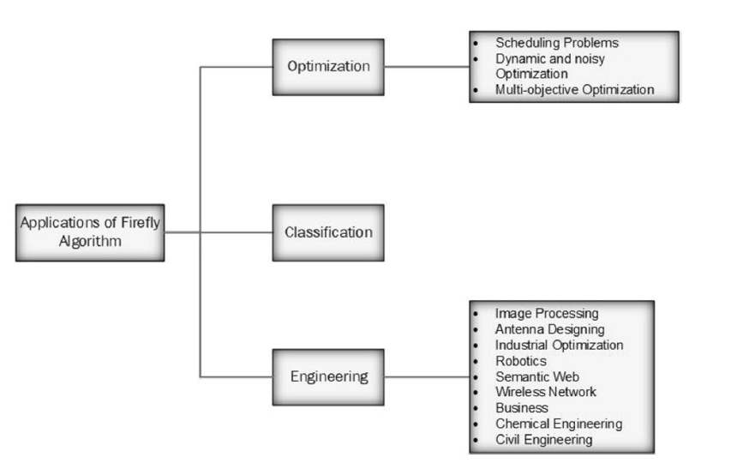

Slide 43
References
Review Article: “A Systematic Review on Harmony Search Algorithm: Theory, Literature, and Applications”, Mathematical Problems in Engineering (2021).
A comprehensive review of firefly algorithms, Swarm and Evolutionary Computation (2013).
A Systematic Review on Firefly Algorithm : Past, Present , and Future, Archives of Computational Methods in Engineering (2021)

Slide 44
Thank You

